Slide 1

Azure Storage Services
-Kishore Chowdary C# Corner MVP
@kishore_1702
#CSharpCorner | #Azure Storage Services @kishore_1702

Slide 2
Agenda:
Azure storage account
Blobs | Tables | Queues | Files | containers
Hands-on application development
#CSharpCorner | #Azure Storage Services @kishore_1702

Slide 3
What is Azure Storage Service?
Azure storage is a foundational building block of Azure. There are different types of service provided by Azure storage and each has it’s own addressable http:// endpoint.
#CSharpCorner | #Azure Storage Services @kishore_1702

Slide 4
Blob
Azure Blob storage is a service that stores unstructured data in the cloud as objects/blobs. Blob storage can store any type of data.
Three types of Blob Types –
Block
Page – for OS
Append – for Audit
#CSharpCorner | #Azure Storage Services @kishore_1702

Slide 5
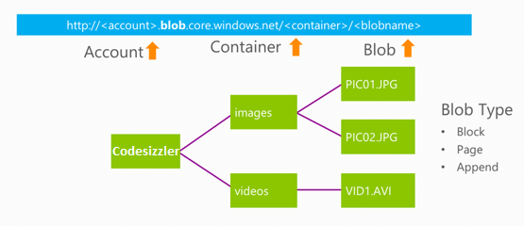
Blob Storage Concept
#CSharpCorner | #Azure Storage Services @kishore_1702

Slide 6
Queues
The queue based storage type service is for processing a set of messages or instructions in the timely basis.
#CSharpCorner | #Azure Storage Services @kishore_1702

Slide 7
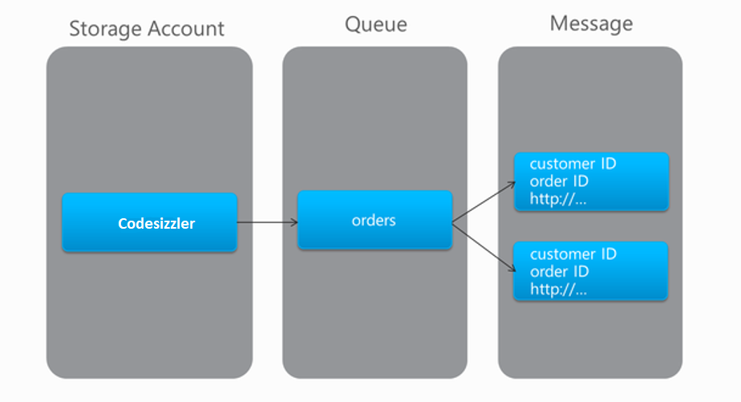
Queue Concept
#CSharpCorner | #Azure Storage Services @kishore_17021

Slide 8
Files
Files storage is nothing but a virtual storage location with the directories inside a storage account where we can store all the data that we have.
#CSharpCorner | #Azure Storage Services @kishore_1702

Slide 9
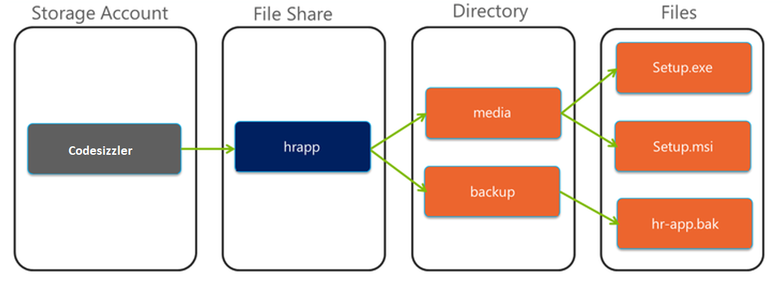
File Concept
#CSharpCorner | #Azure Storage Services @kishore_1702

Slide 10
Table
Table is a structured data compare to the blob which is Unstructured data.
Row is limit less and also the size is limit less.
#CSharpCorner | #Azure Storage Services @kishore_1702

Slide 11
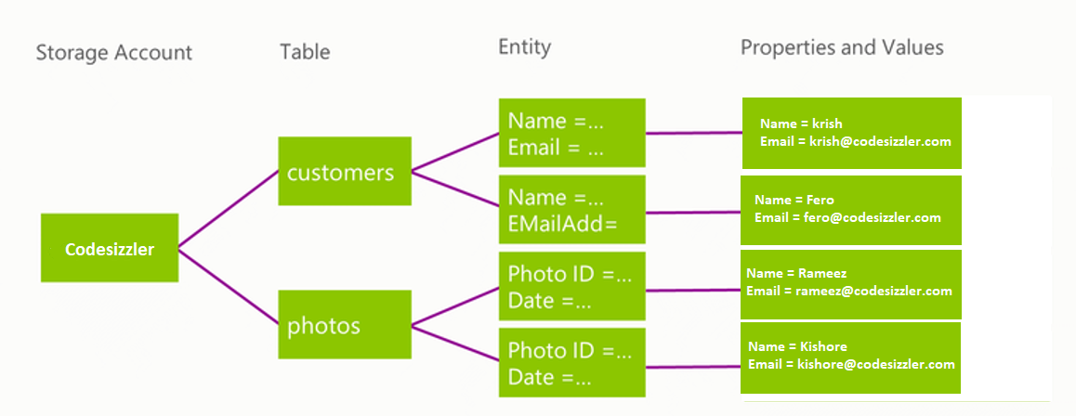
Table Concept
#CSharpCorner | #Azure Storage Services @kishore_1702

Slide 12

Thanks for joining us!!
Kishore Chowdary
Feel free to reach me for any queries:
@kishore_1702
developer.kishore@outlook.com
#CSharpCorner | #Azure Storage Services @kishore_1702

